Slide 1


Digital resilience 2023

Slide 2
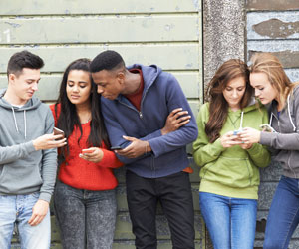
Digital Resilience Campaign
To support schools to build digital resilience in children & young people.
on, anger
An ethos and
environment that
Promotes respect
And values diversity
Curriculum,
teaching and
learning to promote
resilience and support
social and emotional
learning
Digital Resilience
Targeted
support and
Appropriate
referral
Leadership and management
that supports and champions
efforts to promote emotional
health and wellbeing
Enabling
student voice
to influence
decisions
Digital resilience is the ability when online to:
Bounce back from difficult times
Understand when you are at risk
Know what to do if anything goes wrong
Learn from your online experiences
Recover from any online-related difficulties or upsets.
Staff
development
to support their own
wellbeing and that
of students
Working with
parents/carers
Identify need and
monitoring impact of
interventions
Notes:
We want digital resilience to be considered as part of a whole school approach to mental health & wellbeing

Slide 3
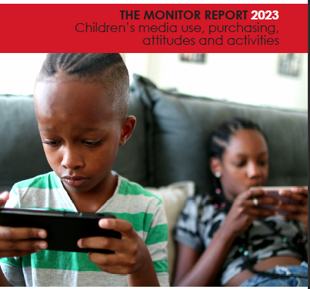
Feedback from the Childwise Monitoring Report 2023
National Context
Notes:
The Childwise monitoring report is a comprehensive annual report focused on children and young people's media consumption, purchasing habits, attitudes and activities.
More than 2000 children in schools across the UK complete the survey.

Slide 4
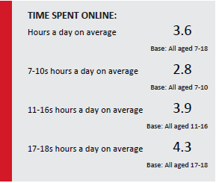

94% of children have a computer at home.
86% have their own computer.
70% have their own mobile phone.
Time spent online
Notes:
From the children surveyed, the average time spent online was 3.6hours per day – this increased with age with teenagers spending around 4hours online.
Accessing technology is not a problem for young people – 94% have a computer at home, 86% have their own computer

Slide 5
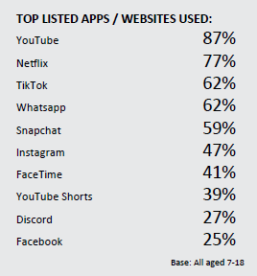
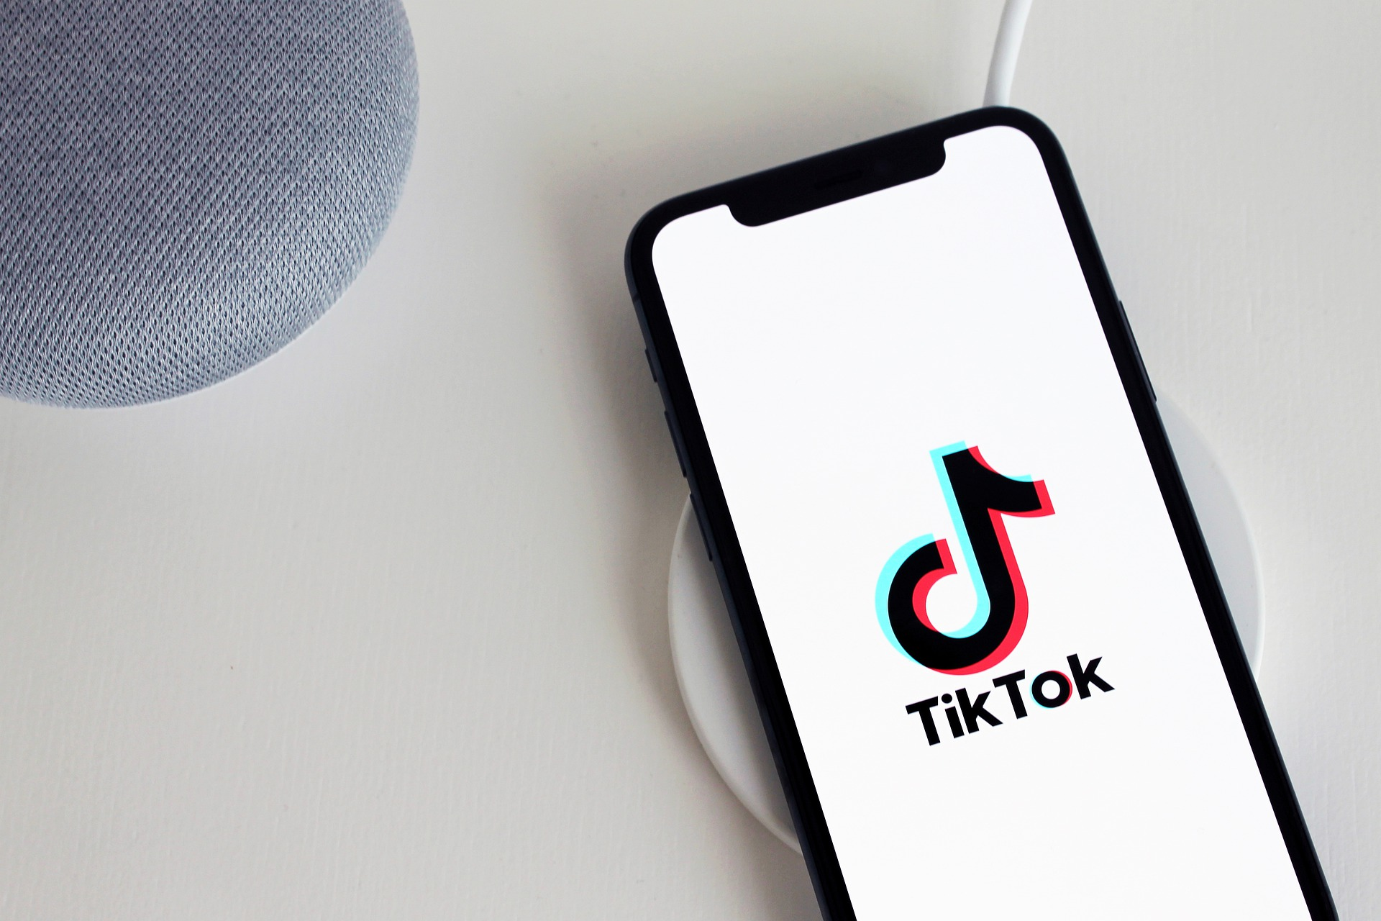
This Photo by Unknown Author is licensed under CC BY-ND
23% children rated TikTok as their favourite app, closely followed by YouTube (21%)
Children spend on average 2.2hrs on TikTok – increasing with age.
43% use TikTok everyday.
55% use YouTube everyday.
Apps
Notes:
We know that young people love watching videos online. Tiktok has replaced YouTube as their favourite app for the first time in 10 years. Around half of young people use tiktok and youtube everyday.

Slide 6
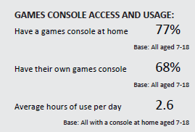

Gaming
Mobile phones are the most used device for gaming (55%), closely followed by a games console (51%).
Boys (2.8hrs) spend more time playing on games consoles compared to girls (1.7hrs).
Notes:
Surprisingly mobile phones are the most used device or gaming. 77% of young people have a games console at home and around 70% have their own. Boys spend more time on average using games consoles than girls.

Slide 7

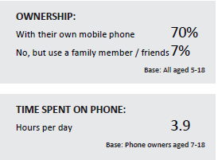
Mobile phones
62% of children and young people have access to their phone at all times (1 in 4 parents check mobile phone usage).
Girls spend more hours per day on a mobile phone compared to boys.
From the age of 9, the mobile phone remains the main device children and young people could not live without – 43%.
Notes:
70% of children and young people have their own mobile phone, spending on average 3.9 hours per day on mobiles. Over 60% have access to their phone at all times.
43% young people from the age of 9 say they cannot live without their mobile phone.

Slide 8
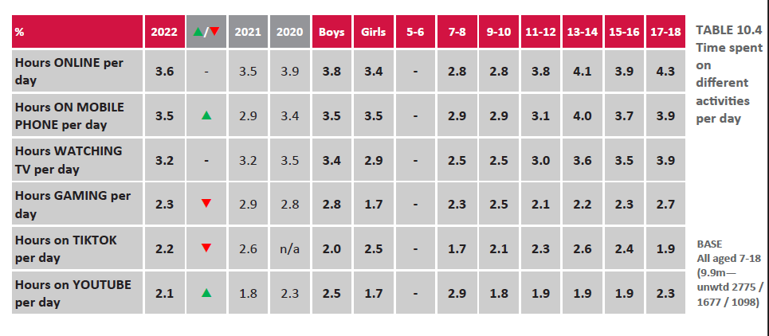
Summary
Notes:
This is a summary and breakdown in terms of ages and usage.
Not all activities increase with age.

Slide 9





Key findings
Almost 9 in 10 (86%) Children and Young People (CYP) aged 5-18 have their own computer.
Almost 7 in 10 CYP (68%) have their own games console, and play games for ~2.3 hours a day
More popular in boys than girls.
The average time spent online for CYP is 3.6 hours per day – increasing with age.
Video sites such as YouTube (87%), Netflix (77%) and TikTok (62%) are used by most children comparatively to other apps.
TikTok is rated the favourite app among CYP, and spend ~2.2 hours a day on it.
WhatsApp remains the most common social networking site.
70% of CYP have a mobile phone and around half reported they could not live without it.
Teenagers spend just under 4 hours per day on their phone.
Notes:
Gaming reduced likely due to the return of more ‘normal’ post-pandemic usage.
Most common equipment for gaming is phones

Slide 10
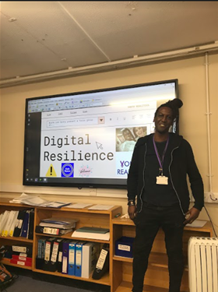
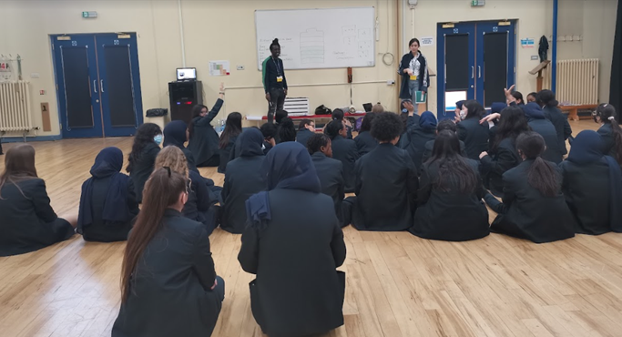
Key findings
Local Context
Most young people used their phones and watched TV daily.
91% of young people surveyed felt more connected to people via technology than offline.
Checking social media was the highlight of the day for many young people.
Aware of online risks but would acknowledge advice to support staying safe online is needed.
Gaming and identity were key issues brought forward
Notes:
Commissioned Youth Realities Most young people used their phone and watched TV daily.
91% of young people surveyed felt more connected to people via technology than offline.
Most young people were honest that on occasions, checking their Instagram, snapchat and other social medias were the highlights of their day.
Young people are aware of potential risks but also realise that more advice is needed to safely navigate the online world.

Slide 11
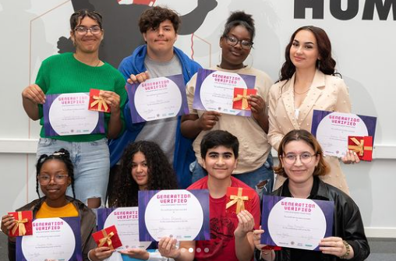
Notes:
‘Generation Verified’. Explores From identity to pressure for perfection, popularity, and the desire for likes, this is a short film explores young people’s experiences of the online world and how they cope with the unique generational challenges that they face.
Co produced group of young Barnet creatives, who experienced all aspects of scriptwriting, acting, film making and directing

Slide 12

Notes:
(9) Generation Verified: A film Led By Barnet Young Voices - YouTube

Slide 13

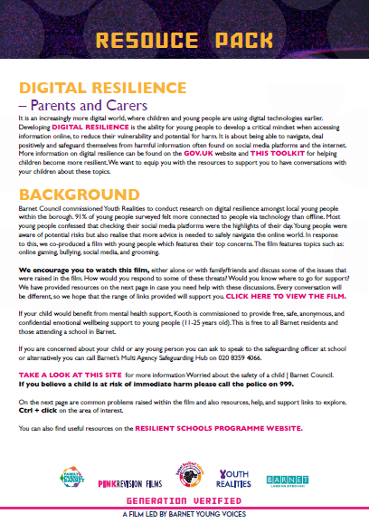
Resource packs
Notes:
We wanted to create some resource packs which would support conversations with parents, young people and teachers after viewing the film. In these links contains lesson plans, advice and guidance for topics that feature in the film.
Youth realities ran focus groups with a group of parents, teachers and young people individually for their opinions and improvements to the resource packs we created. The top image is what they looked like before, and the bottom image shows the changes after the focus group feedback. These are still currently being worked on but should be ready over the next few weeks.

Slide 14
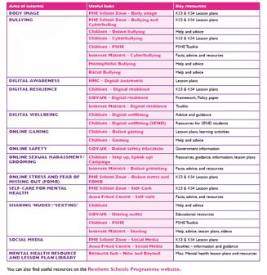
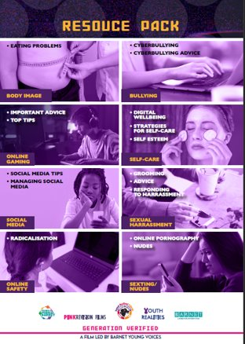
Co production means from this to this

Slide 15


