Slide 1
London Borough of Barnet – local politics

Slide 2
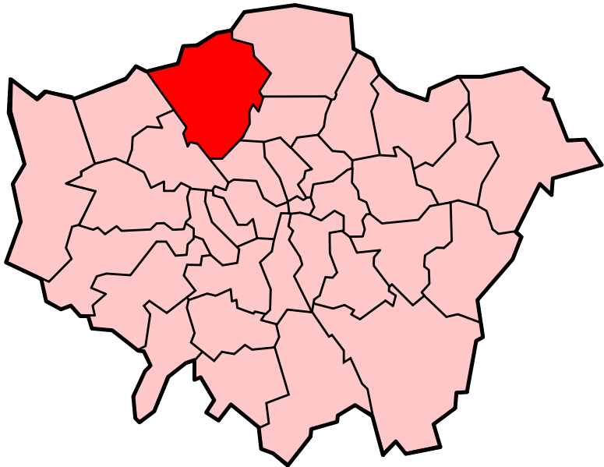
Local Politics -
This is Barnet

Slide 3
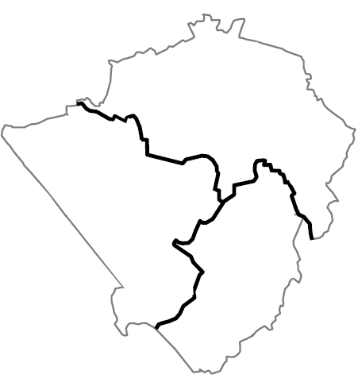
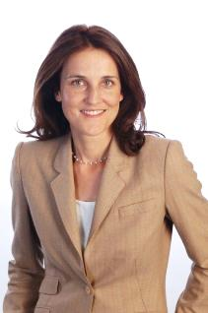
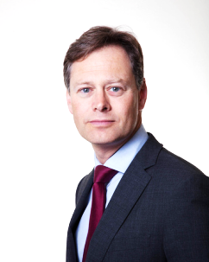
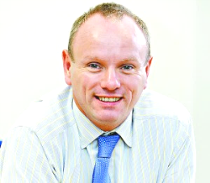
This is how it’s broken up
THREE Parliamentary constituencies, each with an MP
CHIPPING BARNET
Theresa Villiers (Conservative)
N. Ireland Secretary of State
HENDON
Matthew Offord (Conservative)
FINCHLEY & GOLDERS
GREEN
Mike Freer (Conservative)

Slide 4
Councillors
Local Councillors are elected by the community to decide how the council should carry out its various activities
They represent public interest as well as individuals living within their area, or ‘ward’
Elected for a term at local elections
They are one step beneath MPs

Slide 5
Councillors
Local Councillors act: as a Member of the Council, as a representative for residents of their ward and also represent a political party especially during elections.
Member of the Council: Councillors act as a member of the council by being council and committee members and participating in the decision making process of the council and their committees.
Representatives for residents of their ward: Each councillor is a representative of a ward in Barnet, representing the interests of their local community in that ward.
Represent a political party: councillors need to balance the needs of their local area together with the needs of the political party they belong to.

Slide 6
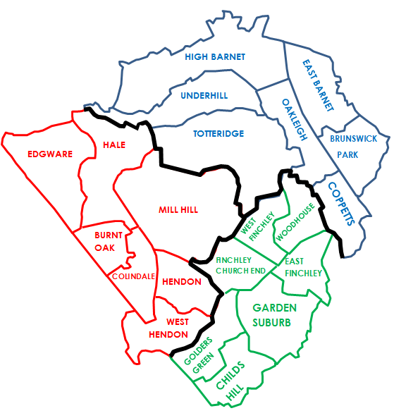
Councillors and wards
3 councillors per ward
21 wards (therefore 63 councillors)
Divided by constituency
32 Conservatives, 30 Labour and 1 Liberal Democrat

Slide 7
So what do those numbers mean…?

Slide 8
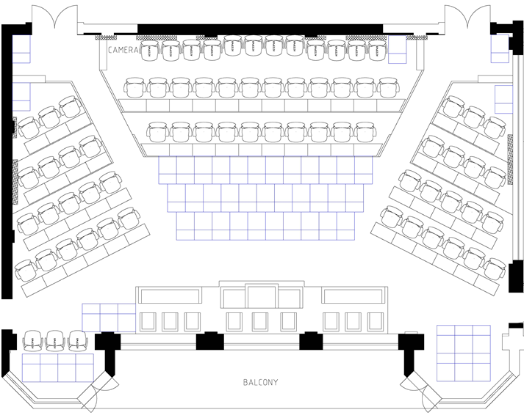
LIB DEM (1)
CONSERVATIVE (32)
LABOUR (30)

Slide 9
Overview – the Committee System
Barnet operates a Commissioning Council organisational model which means that services are delivered through a range of ‘Delivery Units’ (or services) and partnership arrangements. Services may be delivered by the public sector, private sector, voluntary sector or a combination.
As of June 2014 the council changed from an executive model to a Committee system of governance whereby decisions are taken by politically proportionate committees. Political proportionality means that the number of Councillors per Committee reflects the fact that the Administration has a majority of one.

