Slide 1
What’s happening in Barnet

Slide 2
Economic and political context…

Slide 3
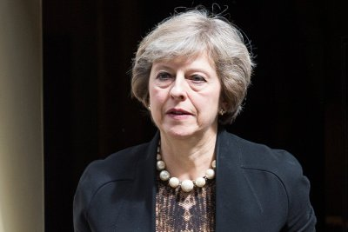
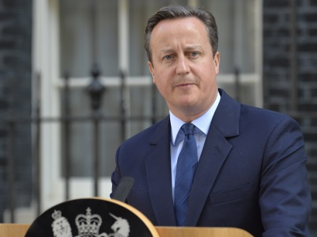
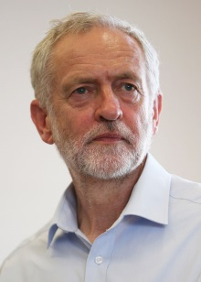
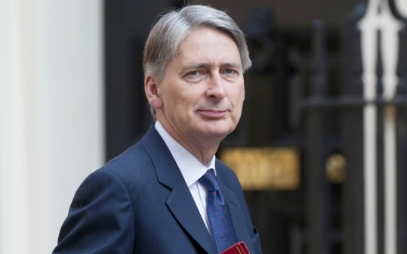
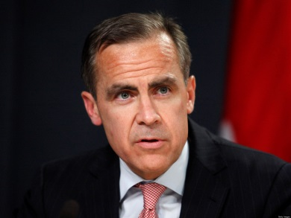
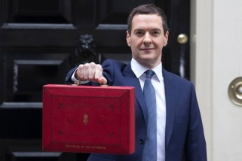
UK POLITICS HAS CHANGED…
UK ECONOMY REMAINS FRAGILE…
IMPACT OF BREXIT..?

Slide 4
Challenges and opportunities in local government
How we’re approaching it in Barnet…

Slide 5
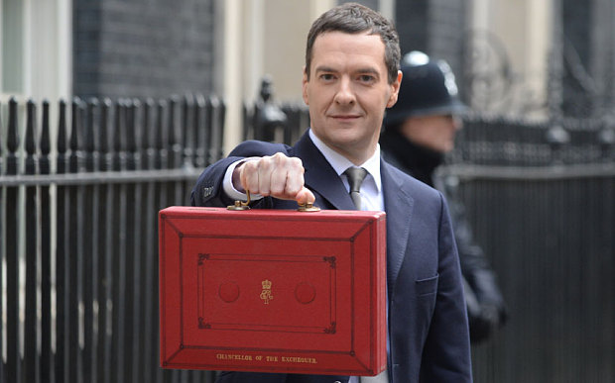
Planning ahead has been crucial…
2008 ‘Future Shape’ project set the framework for Barnet’s response to impending Government austerity programme
‘Future Shape’ became ‘One Barnet’ – our ambitious change programme to achieve £75m (26%) of savings resulting from the 2010 Spending Review

Slide 6
Planning ahead has been crucial…
One Barnet was about reimagining public services for the C21st and asking fundamental questions of local services…
Is this service necessary?
Is this the right model?
Who’s best placed to deliver it?
Then…
Now…

Slide 7
2010 – 2015…

Slide 8
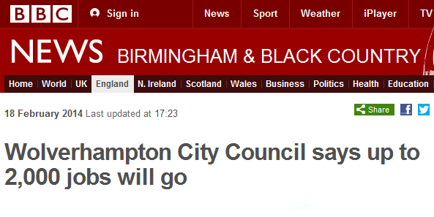
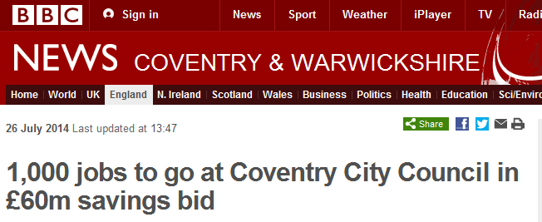
£75m successfully saved in the first half of the decade…
£75m successfully saved during 2010-2015, limited impact on frontline services
Planning ahead avoided mass redundancies
Strong 5 year plan for the future – ahead of most councils:
5 year Corporate Plan
5 year Commissioning Plans for each major service area
5 year budget
Platform for reform through commissioning approach
Notes:
Majority of savings made to 2015 were efficiency savings

Slide 9
High levels of resident satisfaction maintained over the past 5 years…
88% of residents happy with Barnet as a place to live
71% satisfied with how the council runs things, up 8% from 2012
77% feel the council is doing a good job
Notes:
Spring RPS data 2015

Slide 10
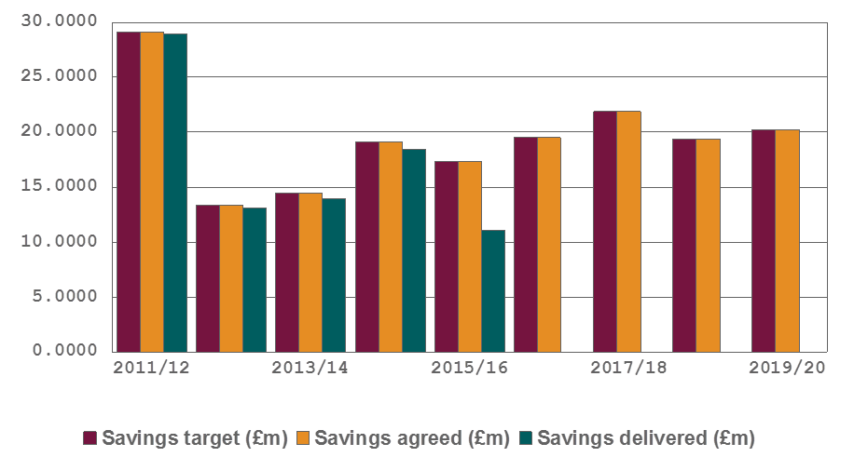
One Barnet programme was ambitious but it only gets us half way there…
In real terms, by the end of the decade we will be spending roughly half what we did at the start…

Slide 11
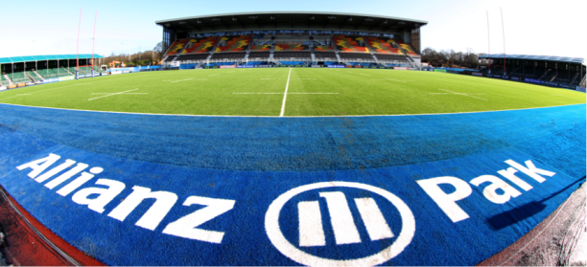
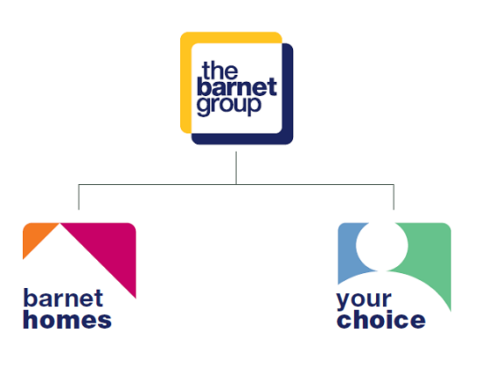
‘Commissioning Council’ approach: A mixed economy of local services providers (public, private, VCS) through a variety of delivery models…

Slide 12
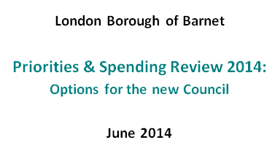
In 2014 we conducted a 12 month Spending Review to develop future plans…
‘Priorities & Spending Review’ – A year long process of analysis and engagement, concluding June 2014, which:
Enabled Councillors to define their strategic priorities & outcomes
Identified transformation proposals for the new administration to consider that enable the council to meet the budget gap to 2020
Communicated, consulted & engaged with residents, partners, customers and businesses

Slide 13
Now conducting a second Review, to set our financial strategy to 2025…
Process will be led by outcomes rather than finance
Focus on demand management
Working in a context of uncertainty, however, this is a time for us to capitalise on opportunities in technology, innovation and maximising income

Slide 14
Our Corporate Priorities

Slide 15
Delivering quality services
Barnet has some of the best schools in the country, excellent parks and open spaces and a successful local business economy
We want to ensure that everyone has access to the opportunities of our borough so that our communities can thrive

Slide 16
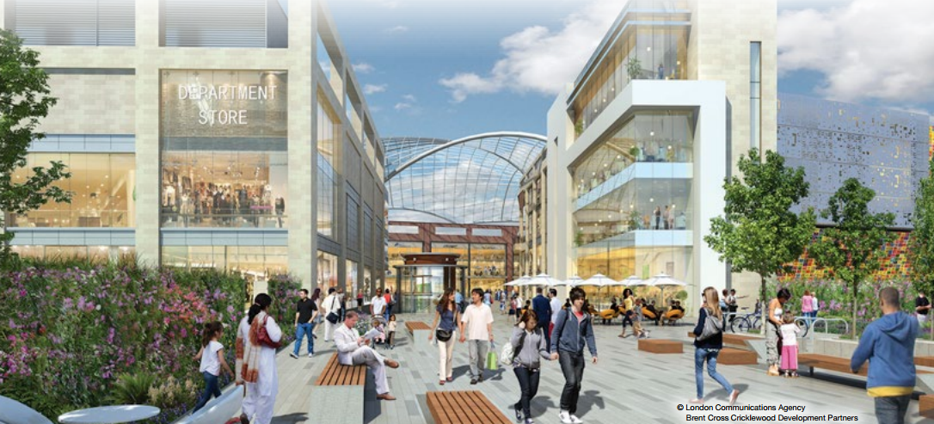
Responsible growth, regeneration and investment
Regeneration, homes, jobs - income for the council, opportunity for residents
Barnet will deliver the most homes in outer London – 20K by 2025
7 major regen schemes, with a pipeline of future development
Joint venture to sell services within and outside Barnet

Slide 17
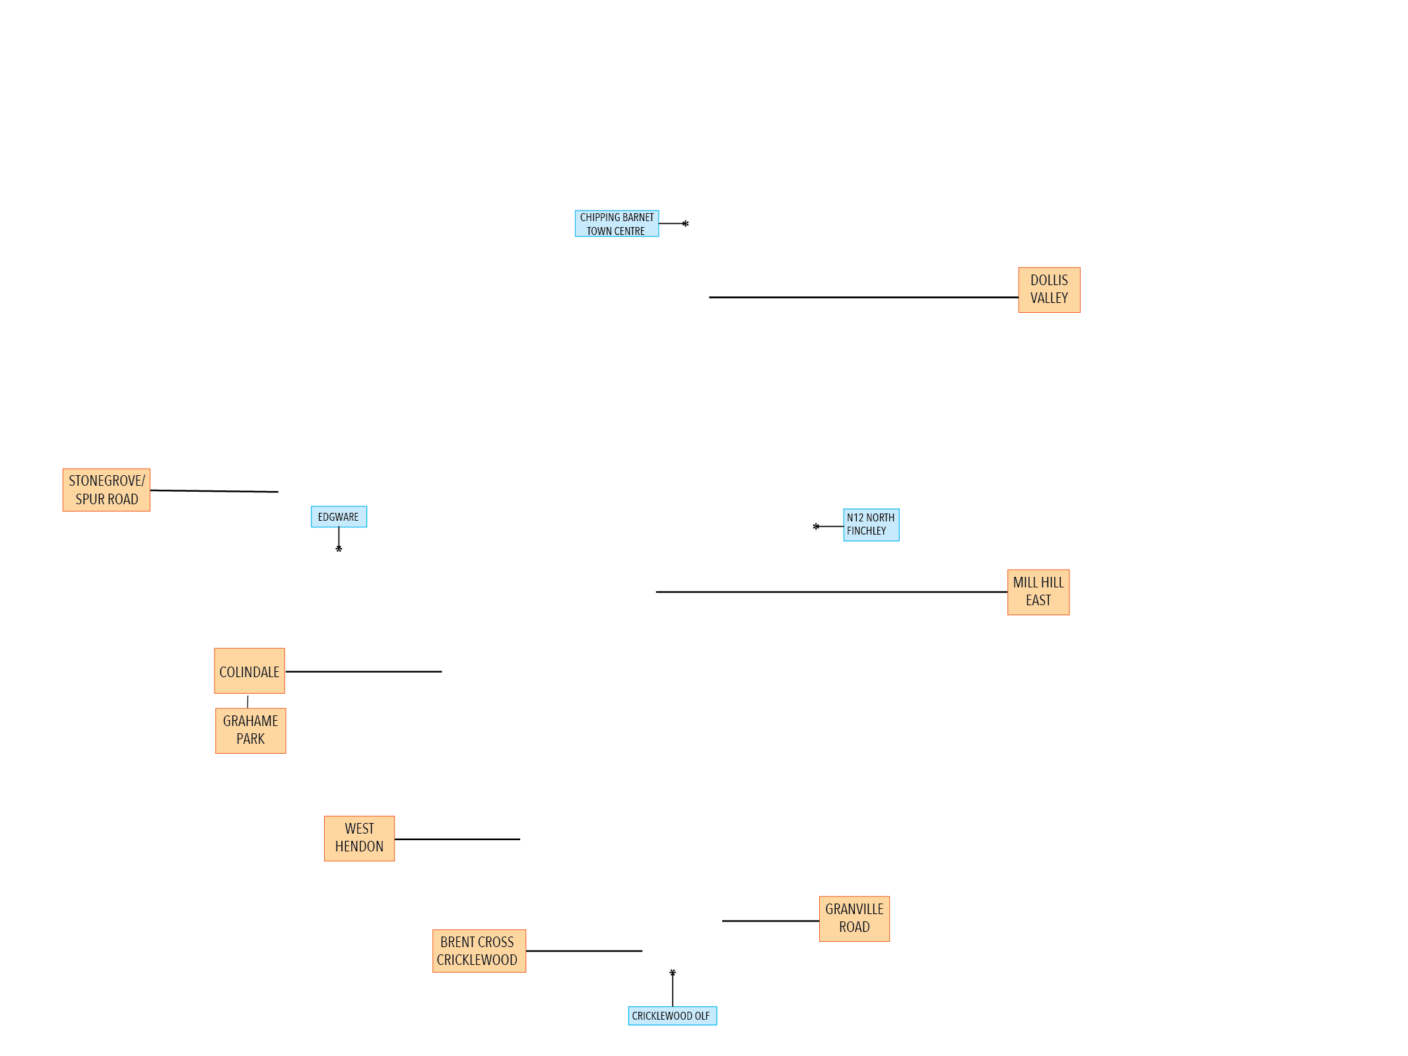
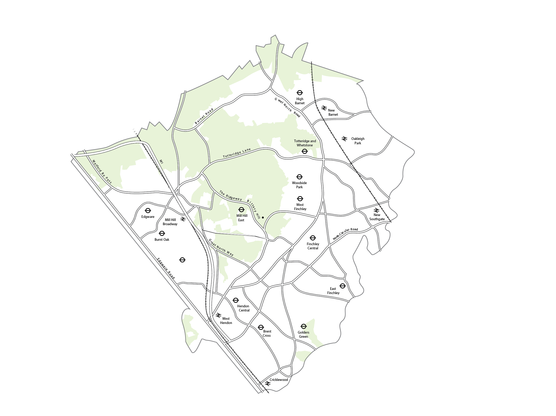
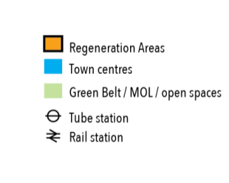
7 major regeneration schemes across the borough…
15,000
HOMES IN REGENERATION AREAS
450
NEW JOBS IN
NEXT 5 YEARS
10
SCHOOLS ACROSS
PRIMARY, SECONDARY &
HIGHER EDUCATION LEVELS
+91,509
SQM OF RETAIL & COMMERCIAL SPACE
DELIVERED IN BRENT CROSS SHOPPING CENTRE
£25m+
NEW HOMES BONUS

Slide 18
Supporting resilient communities and managing demand
Everyone needs to do their bit – helping to keep our streets and parks tidy, recycling more, and looking out for our neighbours etc
But this also means residents having more of a say in the future of their local area, and we will increase our support for those residents and groups who want to take on a more active role.
Our aim is to target our resources at those most in need, and support residents to stay independent for as long as possible.
Notes:
BILT, REACH
Also for those who are not vulnerable – commitment to openness and transparency so eligibility for services is clear and we are held to account for the money we are spending

Slide 19
Transforming local services
Our focus is on achieving the best outcomes for residents whilst delivering value for money to the taxpayer
We work with a range of public, private, and voluntary sector organisations.
Continuing to look at new and innovative ways to deliver local services.

Slide 20
Underpinned by a commitment to improved customer services and transparency...

Slide 21
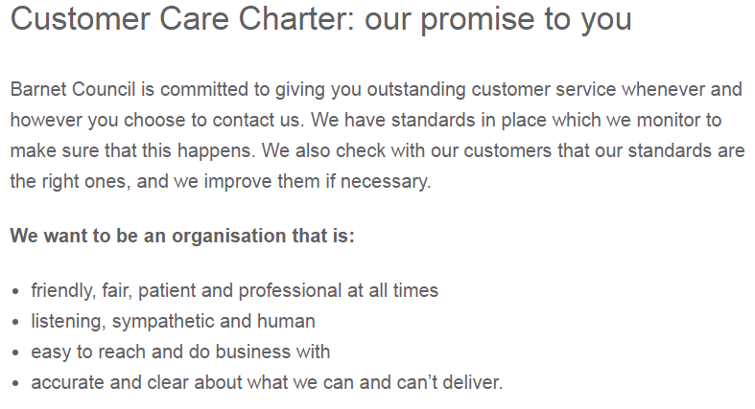
Improving customer services

Slide 22
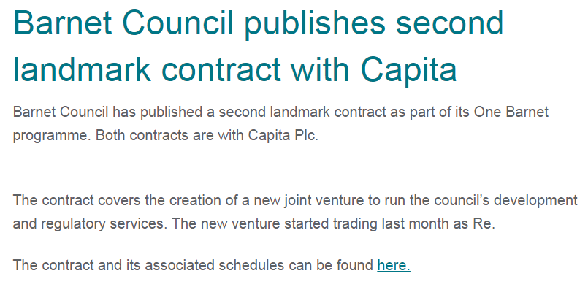
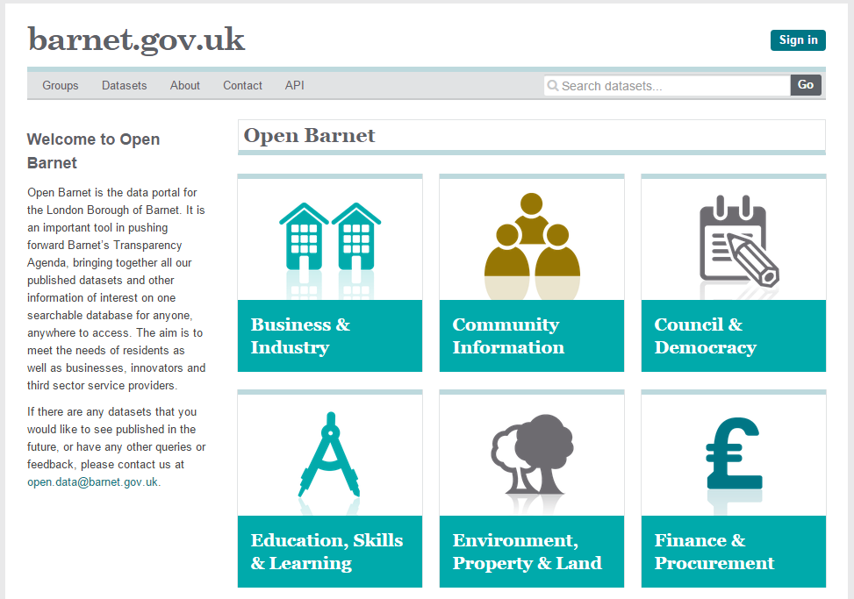
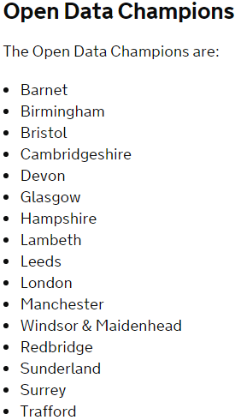
And a continued commitment to openness and transparency…

