Slide 1
Doing Business with the Council
CSG Procurement

Slide 2
Procurement Vision – Simple, Accessible and Local
To deliver quality goods and services at best value for the community of Barnet
To build a resilient and local supply chain
To treat our suppliers fairly with respect and be open and transparent
To make it simple and accessible for suppliers to do business with us

Slide 3
Supplier Champion
Appointed a supplier champion - Susan Lowe
email: susan.lowe@barnet.gov.uk
The supplier champion has the remit to
  enhance links with Barnet’s supplier community
  develop procurement processes that are streamlined and make it easy for suppliers to do business with us
  support local supplier meetings*
  collate feedback from suppliers, listen and action as appropriate
* Regular attendee at FSB monthly meeting

Slide 4
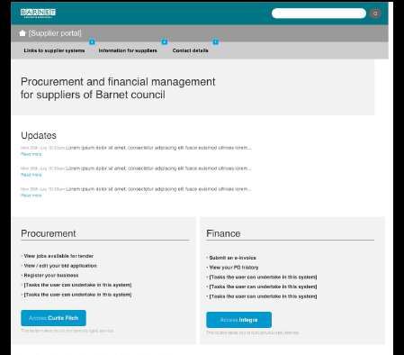
Supplier Portal
One stop shop for supplying to Barnet
  Provide a useful business information tool for suppliers and potential suppliers
Procurement
  Procurement Forward plan
  Link to E-procurement platform
  Tender process guide
Finance
  View your account balance online
  Review when you are due to receive payment
  View the “status” of your invoices (approved/unapproved/on-hold)
  View your Purchase Orders online
  Convert a Purchase Order to an Invoice

Slide 5
Social Value
Requires public authorities to have regard to economic, social and environmental well-being when procuring.
Increased opportunity for SMEs and voluntary sector to compete
Expands the evaluation criteria from simply ‘Price’ and ‘Quality’
Encourages partnerships between organisational types, in pursuit of delivering Social Value objectives

Slide 6
Examples of Social Value
Improve environmental performance and reduce carbon footprint
Source goods and services locally wherever possible.
Work with local suppliers, sub-contractors and agencies to supply services
If any additional labour/trainees are required, enquiries would be made in the local community first.
Use of local supplier to repair and maintain equipment

Slide 7
New EU Procurement Directives currently being updated by the UK Government
The new rules should make it easier for small business to access government opportunities
Consideration to be given to creating “lots” in the procurement
Using social value criteria in the evaluation of tenders

Slide 8
Simplification of the procurement process
Reviewing our procurement templates
  Make it simpler and easier for suppliers to do business with us
eSourcing system
  Does not involve costly resources for suppliers in printing and couriering quotes and tenders to us
  Provides suppliers with an online repository of the their interaction with the Council and an easy way of communicating with the procurement team
Increased use of Quotations
  Barnet only requires quotation for all procurement requirements beneath the OJEU threshold £172k. This means that we have removed the burden on suppliers from preparing costly tender submissions.

Slide 9
Future developments
Increased Market development and market engagement
  Develop the best supply chain and delivery models
Continued simplification of the procurement processes
  Make it easier and better to do business with us
Actively seek feedback and act where appropriate

Slide 10
Summary
Have been working hard towards the procurement vision
Still lots to do
Require your input, What else can we do?

